Slide 1
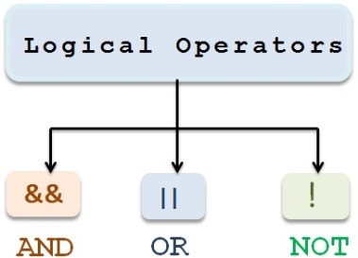
M02 L08
Logical Operators, Multi and Nested if-else and Switch Statements

Slide 2
Today
Check in
Quiz will be at the end of class
Technical Documentation Example https://github.com/heartcombo/devise/blob/main/README.md
Goals:
Learn to Control Flow of Program
Understand and apply Multi-way and nested if-else statements
logical operators (&&, ||, !) to create compound boolean expressions
Write Readable and Maintainable Code

Slide 3
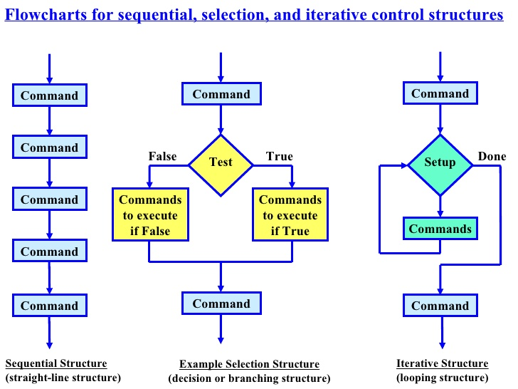
C o n t r o l
Flow of Control
The order in which statements are executed in a program
S​ t​ r​ u​ c​ t​ u​ r​ e​ s​

Slide 4
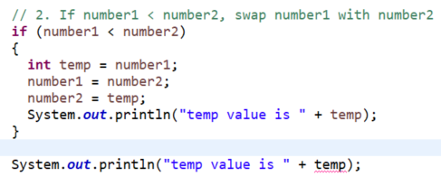
Explore
Open https://liveexample.pearsoncmg.com/liang/intro12e/html/SubtractionQuiz.html
Run animation for this code twice. Once with correct answer and once with incorrect answer
Open https://liveexample.pearsoncmg.com/liang/intro12e/html/SubtractionQuiz.html
Click compile/run button and update the three FILL_CODE_OR_CLICK_ANSWER
Compile and run updated code
Updated SubtractionQuiz to print temp value in if block inside { } and after if{ }
Start { and
end }
of if block
Print value of temp in if block
Print value of temp outside if block
Why is this an error? Look at where temp is declared.

Slide 5
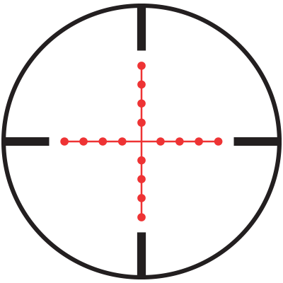
Scope: if else block
Scope is the area of the program that the variable is available
Start { and
end }
of if block
Declared in scope of if block so can only be used between the if start { and end } braces
In scope of if block
Out of scope of if block

Slide 6
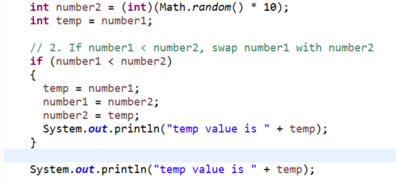
Explore
Add the following to your code
Move to declare temp before if block
Start { and
end }
of if block
Print value of temp inside if block
Print value of temp outside if block
Why is this not an error?

Slide 7
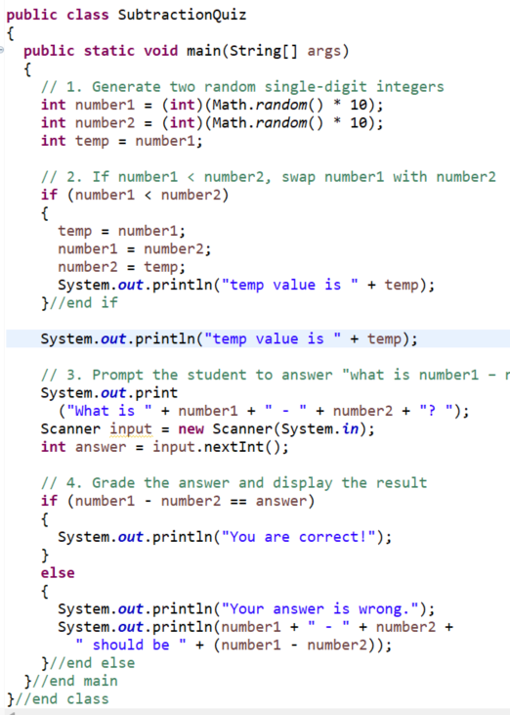
Scope
C
l
ass
Start of main
Declared temp within scope of main
m
a
i
n
m
e
t
h
o
d
i
f
Start of if
Now what is the scope of number1, number2, temp, input, answer?
End of if
What warning is shown in the code? How do you fix it?
i
f
else
End of main

Slide 8
Common Errors and Pitfalls
Note: Do not use ternary operator ? for if else statements
Logic errors
Error that causes your program to produce the wrong result.
If-statements are an area where logic errors are easy to create!
Forgetting Necessary Braces
Causes flow to be incorrect - leads to logical errors
Indentation does not dictate flow of control – it’s only for readability
Always include braces for if else
if (numStudents <= 30)
System.out.println ("Class is available");
else
System.out.println (“Class is not available”);
System.out.println (“You will be placed on the waitlist”);
if (numStudents <= 30)
{
System.out.println ("Class is available");
}
else
{
System.out.println (“Class is not available”);
System.out.println (“You will be placed on waitlist”);
}
Not part of else

Slide 9
Common Errors and Pitfalls
Wrong Placement of Semicolon
Causes flow of control to be incorrect - leads to logical error
DO NOT place a semicolon at the end of if (boolean expression) before curly brace
If you say if (boolean expression);
if (numStudents <= 30);
{
System.out.println ("Class is available");
}

Slide 10

Common Errors and Pitfalls
Using assignment = instead of equality ==
Common issue!
Compiler error – indicates there is a type mismatch - can't convert int to boolean
This is an assignment statement not a boolean expression
if (mathGrade = 90) {
{
//statements
}
Compiler will say it can't convert int to boolean because it is expecting a boolean expression (true or false) not an assignment statement
This means check if the amount the left is equal to the amount on the right. It returns true or false but doesn’t assign an value to a variable.
This means assign a new value to the variable

Slide 11
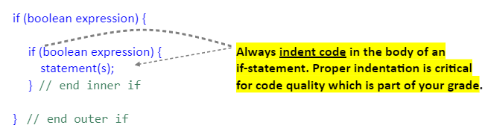
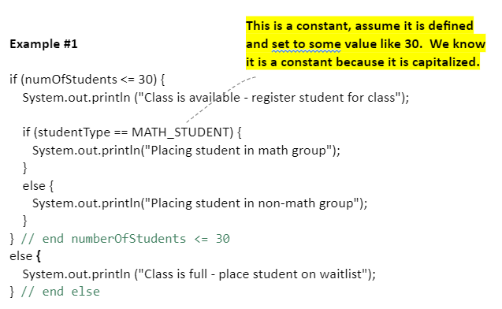
Nested if
You can place if statements inside of other if statements.
This is beneficial when one condition must be true before checking the next condition.
Nested if checks that class is available first
If available then check for type of student
Check out GuessAnimal - Replit

Slide 12
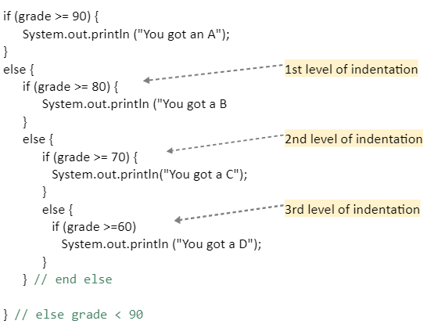
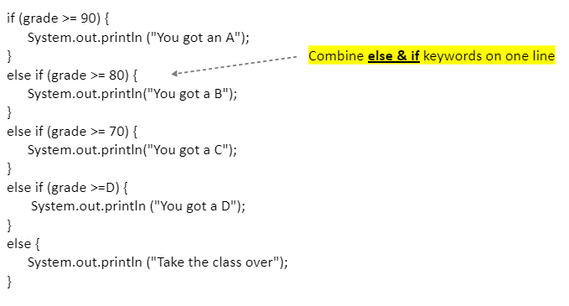
Multi-Way if-else
Multi-way if-else is used when only one condition can be true at a time for the same variable. Here the first condition is tested and if false the next condition is tested. There are two ways to write the conditions as shown below.
Use this way
Do not use this way - harder to read
Notice grade has 5 different options

Slide 13
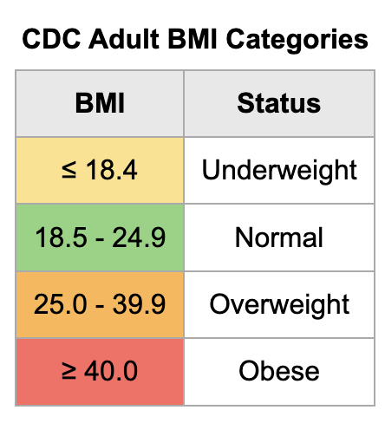

Problem Solving and Test Driven Development
Problem: A person wants to be able to track their BMI results and category as they train.
Open GE02 and go to section 2.1.3 and add test data to make sure you test each category condition. You can use the BMI Calculator to help you create test cases.
This shows minimal testing but what else might be important to test?
How could test cases help write better code?
Test Data | Output
 | Underweight
150.5 lbs 66 inches Bmi 24.3 | Normal
 | Overweight
 | Obese
On paper Design algorithm with pseudocode to display the the bmi category based on the calculation. What algorithm did you choose and why? Talk to the rubber ducky or talk to you team to see if your test data will work.

Slide 14
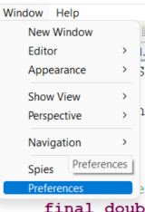
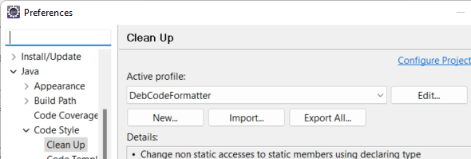
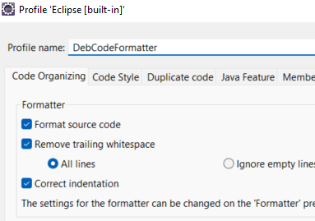
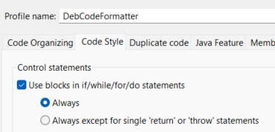
Code Formatting
You can set up Eclipse to clean up your code.

Slide 15
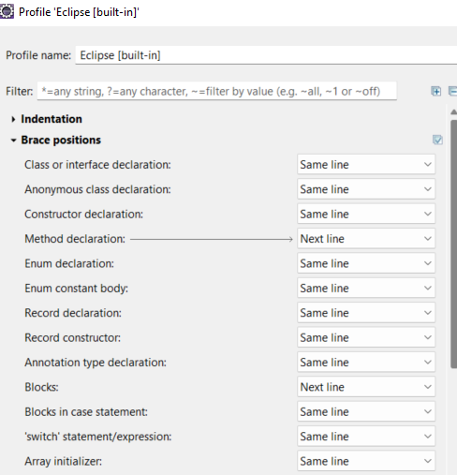
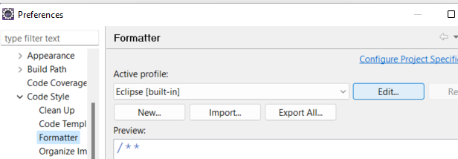
Code Formatting
Go to formatter to change the brace positions.

Slide 16
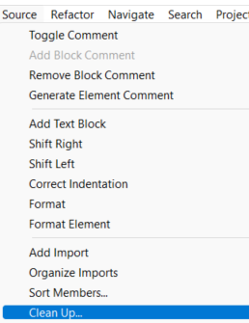
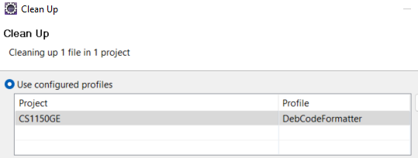
Clean Up Code
Select the profile name you created.
Source -> Clean Up

Slide 17
Preparation
Quiz 40 minutes
Printed technical document for GE01 Module submission - list

